Slide 1
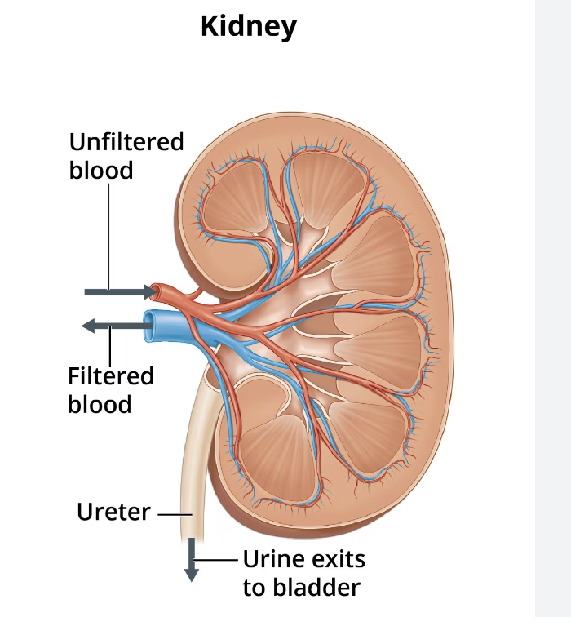
Renal Case Study-
Capstone
Margaret Avallone DNP, RN, CCRN-K, CNE

Slide 2
R. G. is a 64-year-old female patient admitted to the emergency department. PMH: R. G. Type 2 diabetes, HTN, Chronic Kidney disease. Her last eGFR was checked 6 month ago and was 35 mL/min/1.73m2.
1600: Admission note:
Neuro: Client confused and lethargic, disoriented x3. c/o headache. Moving all extremities equally with normal strength.
CV- BP 198/100 HR 90. All pulses 4+ . 3+ pretibial pitting edema.
Respiratory: Resp 18/min. SaO2 93% on room air. Breath sounds- bibasilar crackles.
Abdomen: soft, hypoactive bowel sounds all 4 quadrants.
Integumentary: Skin dry. c/o itching
GU: Urine output- none since admission 4 hours ago

Slide 3
R. G. is a 64-year-old female patient admitted to the emergency department. PMH: R. G. Type 2 diabetes, HTN, Chronic Kidney disease. Her last eGFR was checked 6 month ago and was 35 mL/min/1.73m2.
1600: Admission note:
Neuro: Client confused and lethargic, disoriented x3. c/o headache. Moving all extremities equally with normal strength.
CV- BP 198/100 HR 90. All pulses 4+ . 3+ pretibial pitting edema.
Respiratory: Resp 18/min. SaO2 93% on room air. Breath sounds- bibasilar crackles.
Abdomen: soft, hypoactive bowel sounds all 4 quadrants.
Integumentary: Skin dry. c/o itching
GU: Urine output- none since admission 4 hours ago
Recognize cues: Which of the following 5 assessment findings requires immediate follow-up? Select all that apply (highlight)
Confused, disoriented, lethargic
c/o headache
Type 2 diabetes
Hypoactive bowel sounds
Bibasilar crackles,
SaO2 93%
BP 198/100
Pitting edema
Respiration 18/min

Slide 4
R. G. is a 64-year-old female patient admitted to the emergency department. PMH: R. G. Type 2 diabetes, HTN, Chronic Kidney disease. Her last eGFR was checked 6 month ago and was 35 mL/min/1.73m2.
1600: Admission note:
Neuro: Client confused and lethargic, disoriented x3. c/o headache. Moving all extremities equally with normal strength.
CV- BP 198/100 HR 90. All pulses 4+ . 3+ pretibial pitting edema.
Respiratory: Resp 18/min. SaO2 93% on room air. Breath sounds- bibasilar crackles.
Abdomen: soft, hypoactive bowel sounds all 4 quadrants.
Integumentary: Skin dry. c/o itching
GU: Urine output- none since admission 4 hours ago
Recognize cues: Which of the following 5 assessment findings requires immediate follow-up? Select all that apply (highlight)
Confused, disoriented, lethargic
c/o headache
Type 2 diabetes
Hypoactive bowel sounds
Bibasilar crackles,
SaO2 93%
BP 198/100
Pitting edema
Respiration 18/min

Slide 5
Labs are drawn. Which two lab findings require immediate follow up?
Hgb: 8.6 (14-17.5 gm/dl)
Platelets: 92,000/mcL, (150,000-450,000/mcL)
BUN: 32 mg/dL (6-24 mg/dl)
Cr: 3.8 mg/dL, (0.74-1.35)
Na: 122 mEq/L, (135-145 mEq/L)
K: 6.3 mEq/L, (3.5-5 mEq/L)
Glucose: 168 mg/dL. (70-100 mg/dl)

Slide 6
Labs are drawn. Which two lab findings require immediate follow up?
Hgb: 8.6 (14-17.5 gm/dl)
Platelets: 92,000/mcL, (150,000-450,000/mcL)
BUN: 32 mg/dL (6-24 mg/dl)
Cr: 3.8 mg/dL, (0.74-1.35)
Na: 122 mEq/L, (135-145 mEq/L)
K: 6.3 mEq/L, (3.5-5 mEq/L)
Glucose: 168 mg/dL. (70-100 mg/dl)

Slide 7
Analyze cues: Which of the following conditions could the client be experiencing? Select all that apply
Diabetes insipidus
Worsening chronic kidney disease (CKD) with acute fluid overload
Hyperglycemic Hyperosmolar nonketotic syndrome (HHNS)
SIADH
Cerebral vascular accident (CVA)

Slide 8
Analyze cues: Which of the following conditions could the client be experiencing? Select all that apply
 | CHF | AKI | SIADH | CVA | CKD with Fluid overload
Bibasilar crackles
hyperkalemia
Na 122
SaO2 93%
confusion, disorientation

Slide 9
Analyze cues: Which of the following conditions could the client be experiencing? Select all that apply
 | CHF | AKI | SIADH | CVA | CKD with Fluid overload
Bibasilar crackles | x | x | x |  | x
hyperkalemia |  | x |  |  | x
Na 122 |  | x | x |  | x
SaO2 93% | x | x | x |  | x
confusion, disorientation | x | x | x | x | x

Slide 10
Prioritize hypotheses. (If the patient gets worse, what could happen?)
Prioritize hypothesis. (List top 3 problems).
The client is at risk of _________as evidenced by _____
2. The client is at risk of ______ as evidenced by _________
3. The client is at risk of ________ as evidenced by _________

Slide 11
Prioritize hypotheses. List top three problems
Prioritize hypothesis. (List top 3 problems).
The client is a risk of _cardiac arrest as evidenced by K+ 6.3
2. The client is a risk of _seizures as evidenced by Na 122, confusion, headache
3. The client is a risk of _ worsening resp distress as evidenced by bibasilar crackles, SaO2 93,

Slide 12
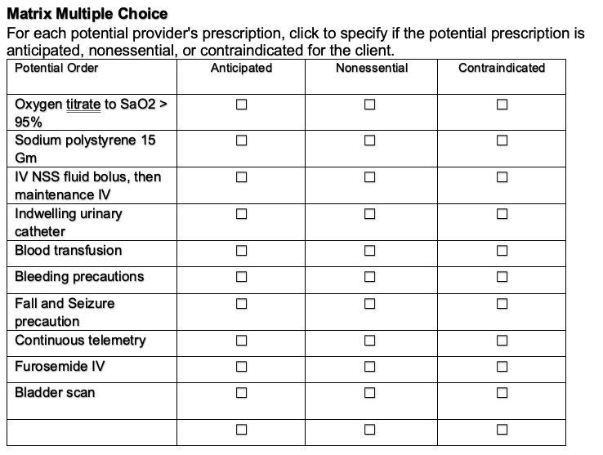

Slide 13
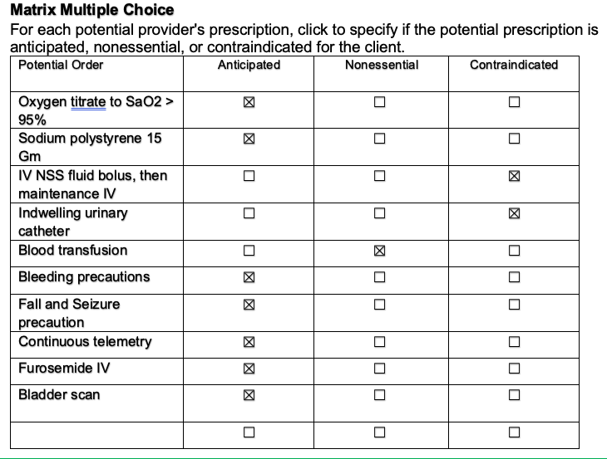

Slide 14
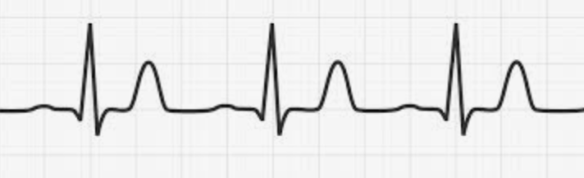
At 2000, the continuous ECG notes the following:
What is the rhythm?
List 4 interventions in priority order to treat the rhythm noted.
___
___
___
___

Slide 15
At 2000, the continuous ECG notes the following:
What is the rhythm? sinus rhythm with peaked T waves (can’t assess rate).
List 4 interventions in priority order to treat the rhythm noted.
___calcium gluconate (or calcium chloride)-protects heart from cardiac arrest.
___regular insulin IV with dextrose 50% insulin carries K+ into cell in exchange for Na+
___ salbutamol/albuterol-Also stimulates Na/K+ pump
___sodium bicarbonate IV (if acidosis present) Exchanges K+ for H+
-----furosemide IV- may help to lower K+ Loop diuretics still used in stages 4 and 5 CKD
___sodium polystyrene (kayexylate) po Exchanges Na for K+ in intestines. Benefit- removes K+ from the body. Downside- not fast. Need working gut.
___ emergent hemodialysis- Yes- removes K+ but you need central line/

Slide 16
It is determined that the patient requires emergency hemodialysis. A temporary vascular access device has been placed via the internal jugular for emergent dialysis. Her first treatment takes place in her hospital room with a portable machine but she will later need ongoing dialysis when her condition stabilizes.
List at least two indications for emergent hemodialysis:
1.
2.

Slide 17
It is determined that the patient requires emergency hemodialysis. A temporary vascular access device has been placed via the internal jugular for emergent dialysis. Her first treatment takes place in her hospital room with a portable machine but she will later need ongoing dialysis when her condition stabilizes. List indications for emergent hemodialysis
A- Acidosis – Severe metabolic acidosis
E- Electrolyte disorders most often hyperkalemia
I- Intoxication- methanol, ethylene gylcol, lithium, salicylates
O- Overload of volume
U- uremia causing pericarditis, encephalopathy,

Slide 18
Ms. G is stabilized and discharge teaching is initiated. Which of the following topics should be included in the discharge instructions?
Try to keep your blood glucose within the target range
Take your medications as prescribed.
Take ibuprofen rather than acetaminophen for mild pain
Limit salt in your diet by using salt substitutes.
Call your provider with worsening swelling in your arms or feet or trouble breathing
Do not smoke
What else should be included in the instructions? Diet?
What medications do you anticipate the patient will be discharged to home?

Slide 19
Ms. G is stabilized and discharge teaching is initiated. Which of the following topics should be included in the discharge instructions?
Try to keep your blood glucose within the target range
Take your medications as prescribed.
Take ibuprofen rather than acetaminophen for mild pain
Limit salt in your diet by using salt substitutes.
Call your provider with worsening swelling in your arms or feet or trouble breathing
Do not smoke
What else?
https://www.saintlukeskc.org/health-library/discharge-instructions-chronic-kidney-disease
Diet

Slide 20
What additional dietary instructions should be provided?
 | choose | avoid
pasta
noodles
milk
tortillas
oranges
spinach
tomatoes
broccoli
peanut butter
Cola drinks
beans
salty snacks
lean meat
eggs
canned soup

Slide 21
What additional dietary instructions should be provided?
 | choose | avoid
pasta | x
noodles | x
milk |  | x
tortillas | x
oranges |  | x
spinach |  | x
tomatoes |  | x
broccoli |  | x
peanut butter |  | x
Cola soft drinks |  | x
beans |  | x
salty snacks |  | x
lean meat | x
eggs | x
canned soup |  | x

Slide 22
Medication management
Antihypertensives- usually ACE-I or angiotensin II receptor blockers
Diuretic- loop (furosemide, bumetanide, torsemide)
Erythropoetin
Phosphate binders-Calcium acetate, Sevelamer
Calcium/Vit D supplement

